Slide 1
LabVIEW
Contact:- 8319146306
Mail:- arinrharsh@gmail.com
Getting Start
Part 2
Nitesh Pradhan
B.Tech Gold Medalist
NIT Raipur
Former Academic Partner of National Instruments

Slide 2
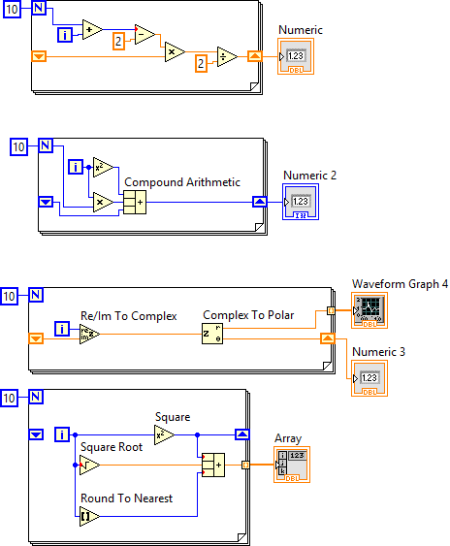
Level one
Solve and give the answer of all Problem
Note:- Right click in the border of for loop and add shift register

Slide 3
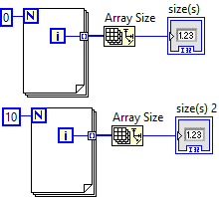
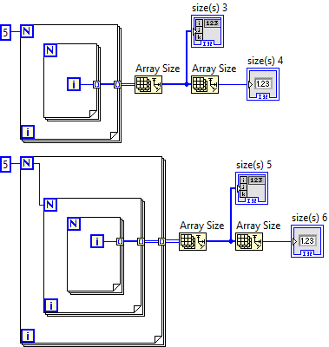
Level one
Solve and give the answer of all Problem
Note:

Slide 4
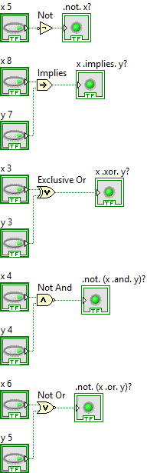
Level Two
Solve and give the answer of all Problem
Note: Use Boolean Function Palettes

Slide 5
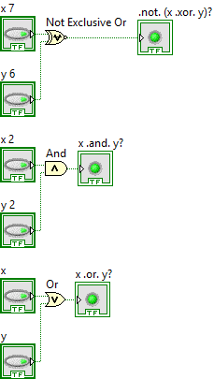
Level Two
Solve and give the answer of all Problem
Note:

Slide 6
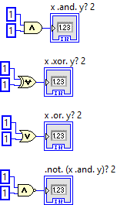
Level Two
Solve and give the answer of all Problem
Note:

Slide 7
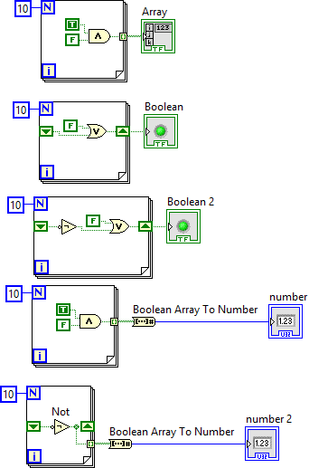
Level Two
Solve and give the answer of all Problem
Note:

Slide 8
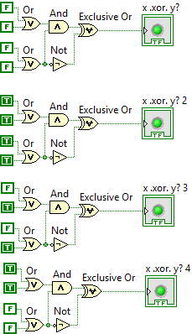
Level Two
Solve and give the answer of all Problem
Note:

Slide 9
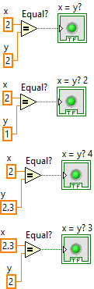
Level Two
Solve and give the answer of all Problem
Note:

Slide 10
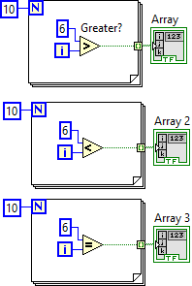
Level Two
Solve and give the answer of all Problem
Note:

Slide 11
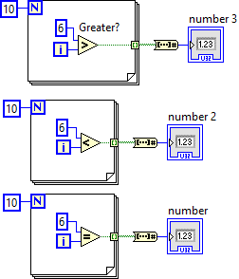
Level Two
Solve and give the answer of all Problem
Note:

Slide 12
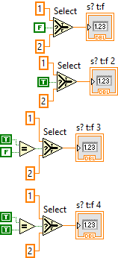
Level Two
Solve and give the answer of all Problem
Note:

Slide 13
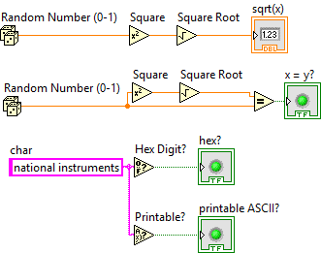
Level Two
Solve and give the answer of all Problem
Note:

Slide 14
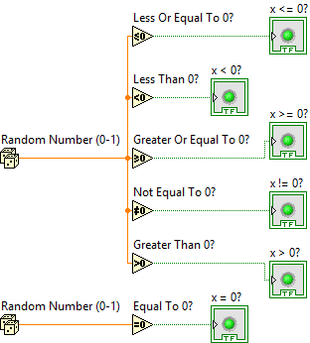
Level Two
Solve and give the answer of all Problem
Note:

Slide 15
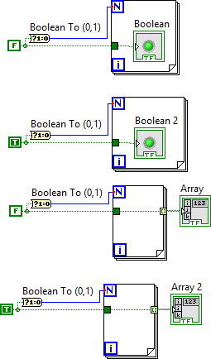
Level Two
Solve and give the answer of all Problem
Note:

Slide 16
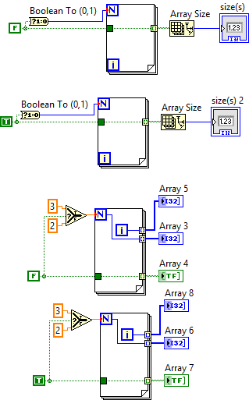
Level Two
Solve and give the answer of all Problem
Note:

Slide 17
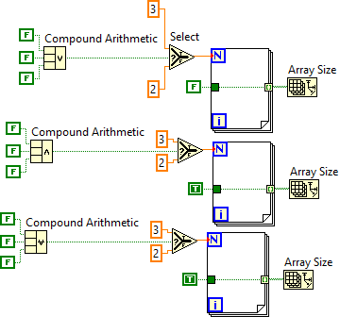
Level Two
Solve and give the answer of all Problem
Note:

Slide 18
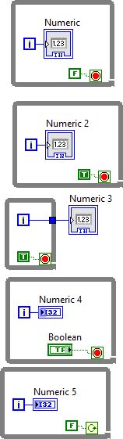
Level Two
Solve and give the answer of all Problem
Note:

Slide 19
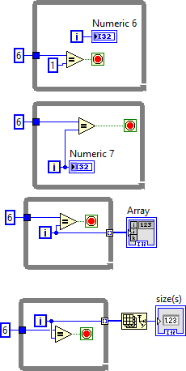
Level Two
Solve and give the answer of all Problem
Note:

Slide 20
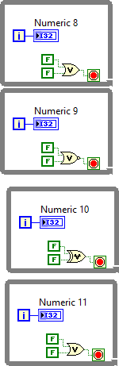
Level Two
Solve and give the answer of all Problem
Note:

Slide 21
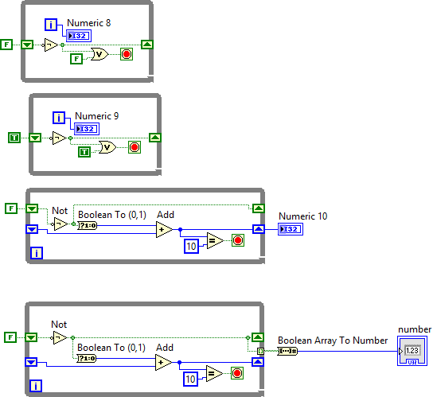
Level Two
Solve and give the answer of all Problem
Note:

Slide 22
Please Share with new LabVIEW users
Thank you

